Slide 1

Identification of Switchback Intervals in Parker Space Probe Data
University of Arizona
Klein Plasma Research Lab
Faculty Mentor: Dr. Kristopher Klein
Postdoctoral Mentor: Dr. Mihailo Martinovic
Intern: Noa Nishizawa

Slide 2
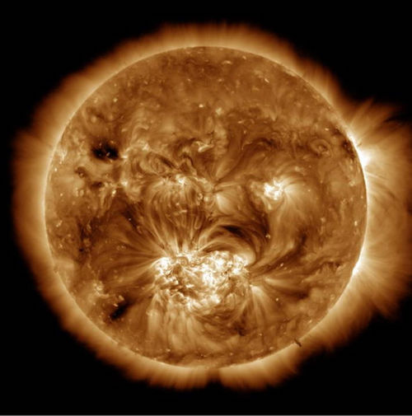
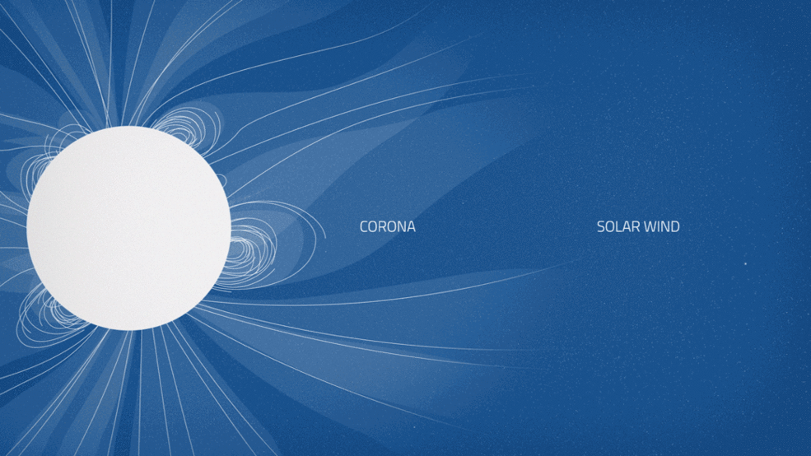
The Solar Corona and Solar Wind
Solar corona is outermost part of Sun’s atmosphere, which is hundreds of times hotter than the Sun’s surface
High temperature causes particles to move at extreme speeds and gain energy to escape the Sun’s gravity, resulting in the solar wind
This extended atmosphere and solar wind has been studied for approximately 50 years
Image of Solar Corona from NASA’s Solar Dynamics Observatory.
Credit: NASA
Conceptual animation of Sun’s corona and solar wind. Credit: NASA Goddard Space Flight Center

Slide 3
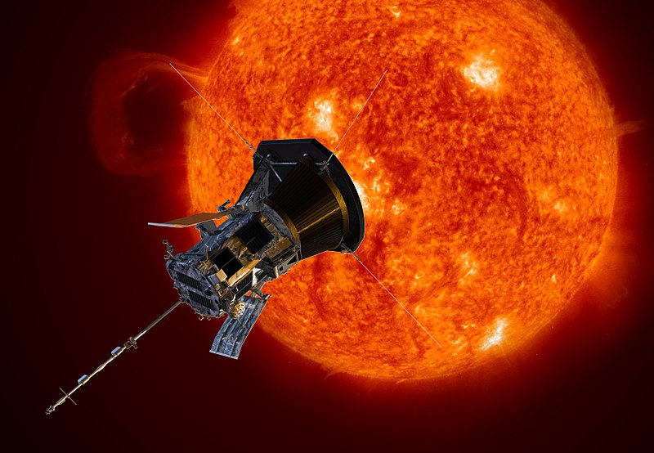
NASA’s Parker Space Probe (PSP)
Named after Eugene Newman Parker
  1st to predict supersonic solar wind (Parker 1958)
1st spacecraft to fly into low solar corona
  Above photosphere, magnetically dominated, relatively near Sun (< few million miles of surface)
Objectives
  Trace energy flow
  Determine structure and dynamics
  Explore particle mechanisms
Artistic rendition of Parker Space Probe
https://commons.wikimedia.org/wiki/File:Parker_Solar_Probe.jpg

Slide 4
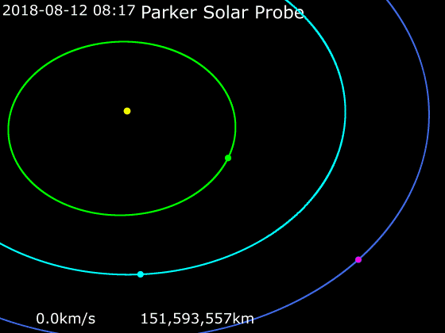
Parker Space Probe (PSP) Trajectory
An animation of Parker Solar Probe's trajectory from August 7, 2018 to August 29, 2025:
https://commons.wikimedia.org/wiki/File:Animation_of_Parker_Solar_Probe_trajectory.gif

Slide 5
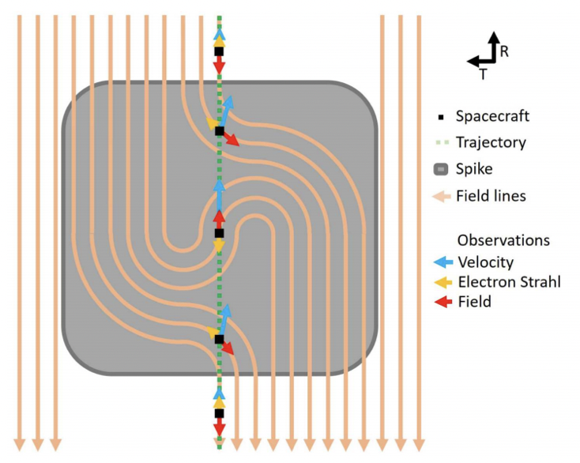
Alfvenic Velocity Spikes (“Switchbacks”)
Magnetic field reversals associated spikes in thermal particle velocity
Magnetic field and thermal particle data show abrupt reversals
Structures suggested to correlate with solar wind speed fluctuations
Schematic of an S-shaped magnetic structure
Alfvenic Velocity Spikes and Rotational Flows in the Near-Sun Solar Wind (Kasper 2019)

Slide 6
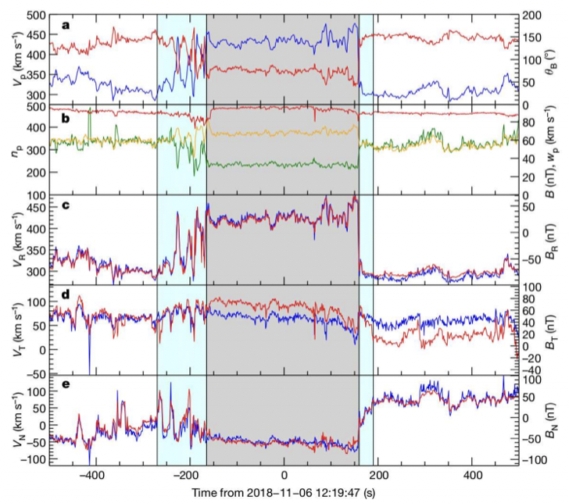
Switchback Example
5 defined regions
  Leading quiet
  Leading transition
  Switchback
  Post transition
  Post quiet
Grey area indicates switchback period
  Blue area indicates transition regions
Alfvenic Velocity Spikes and Rotational Flows in the Near-Sun Solar Wind (Kasper 2019)

Slide 7
Questions of Interest
How will a manual switchback identification procedure and quantification of biases in that detection process compare with identified switchbacks using other methods?
Will a newly identified switchback set challenge theories on switchback formation, distinguishing between magnetic reconnection, shear-driven turbulence, and slow/fast wind interaction as potential sources?

Slide 8
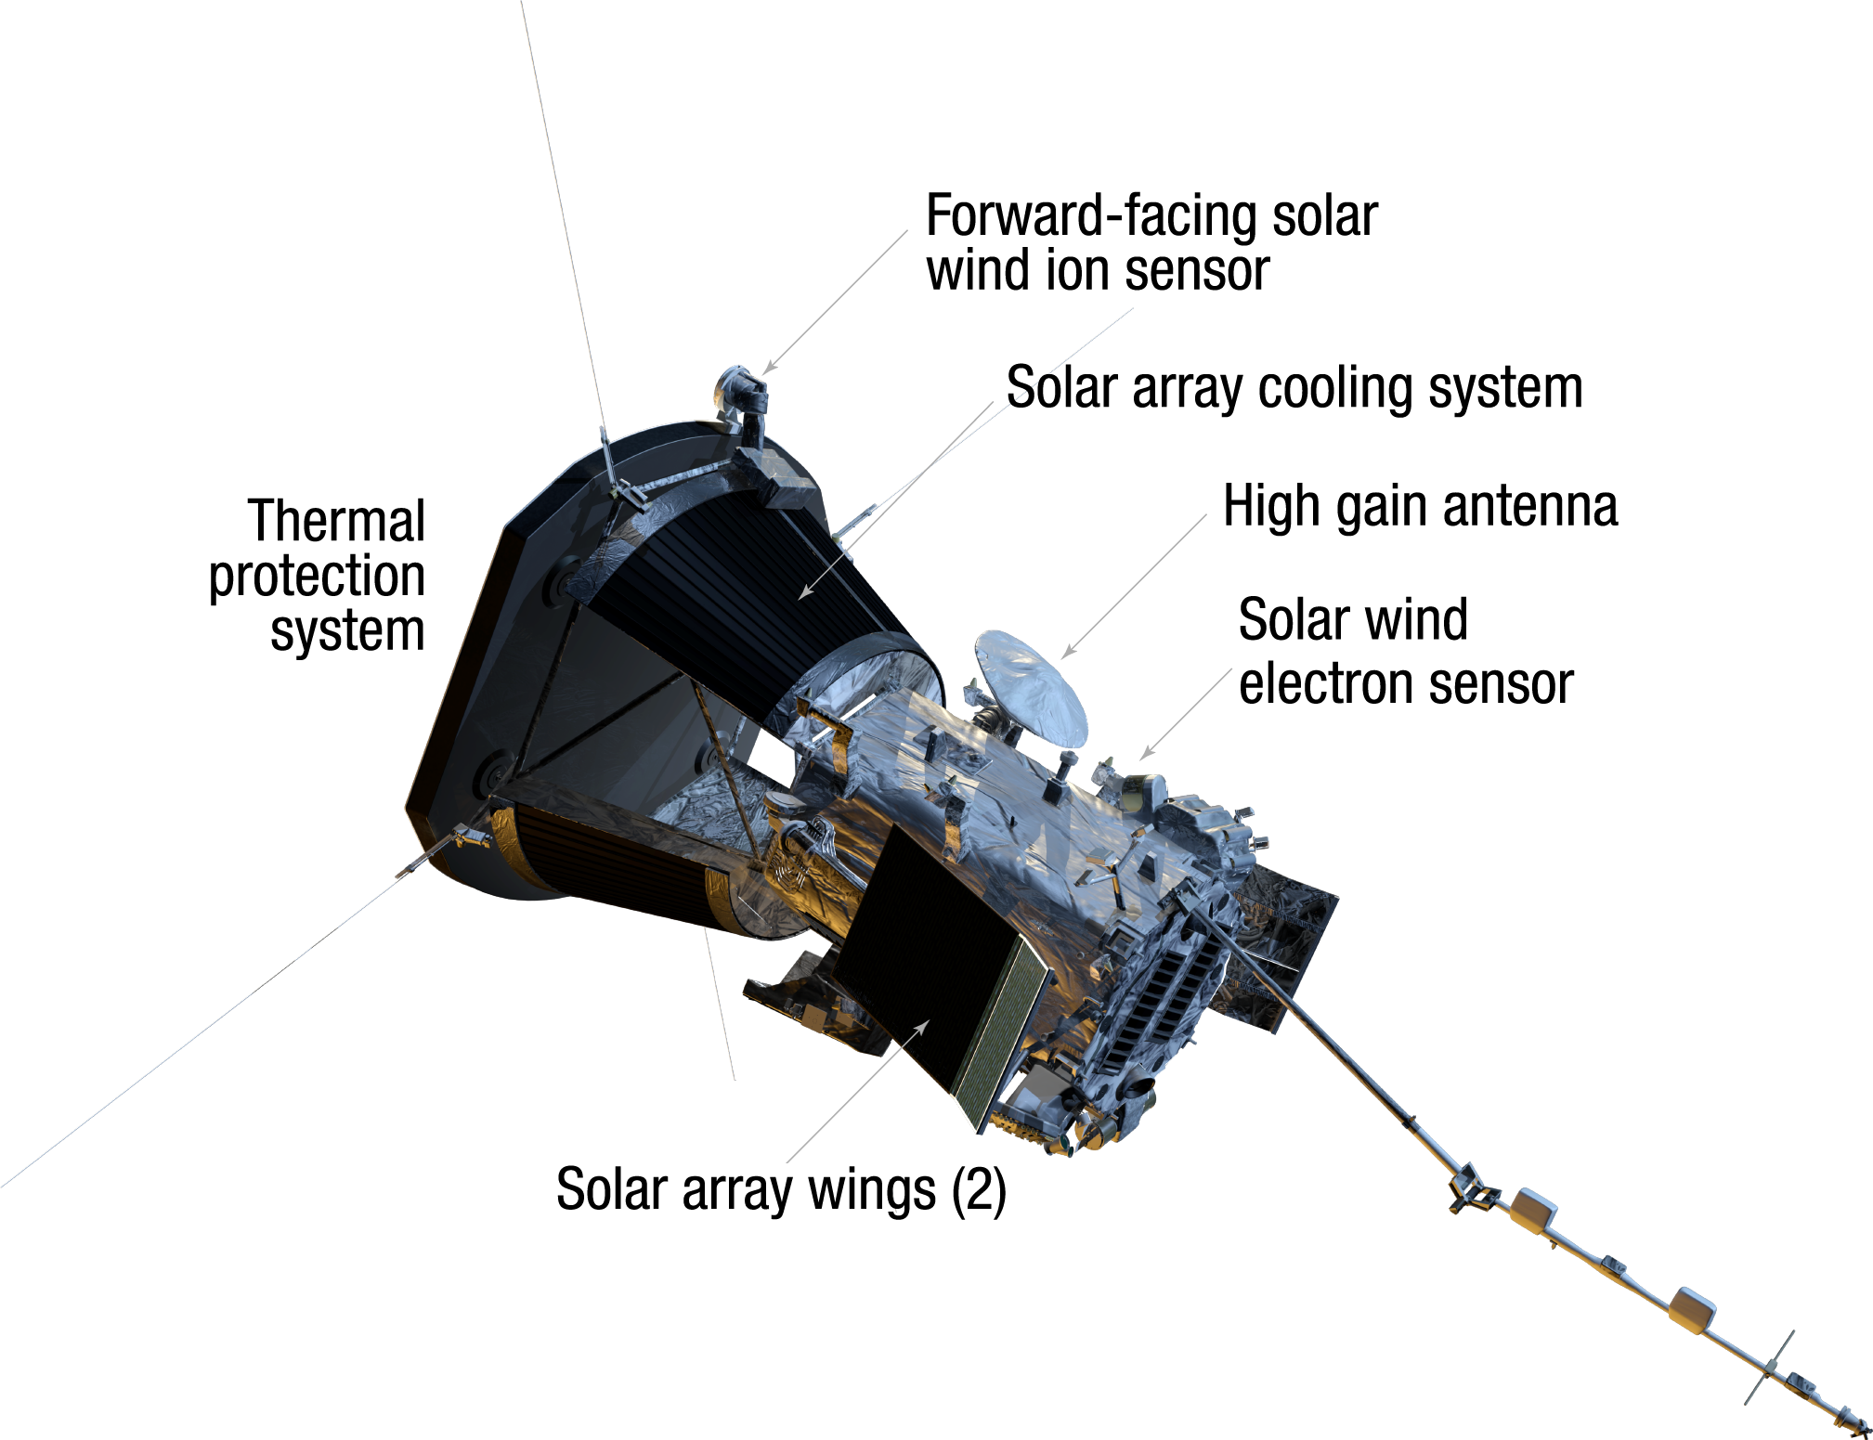
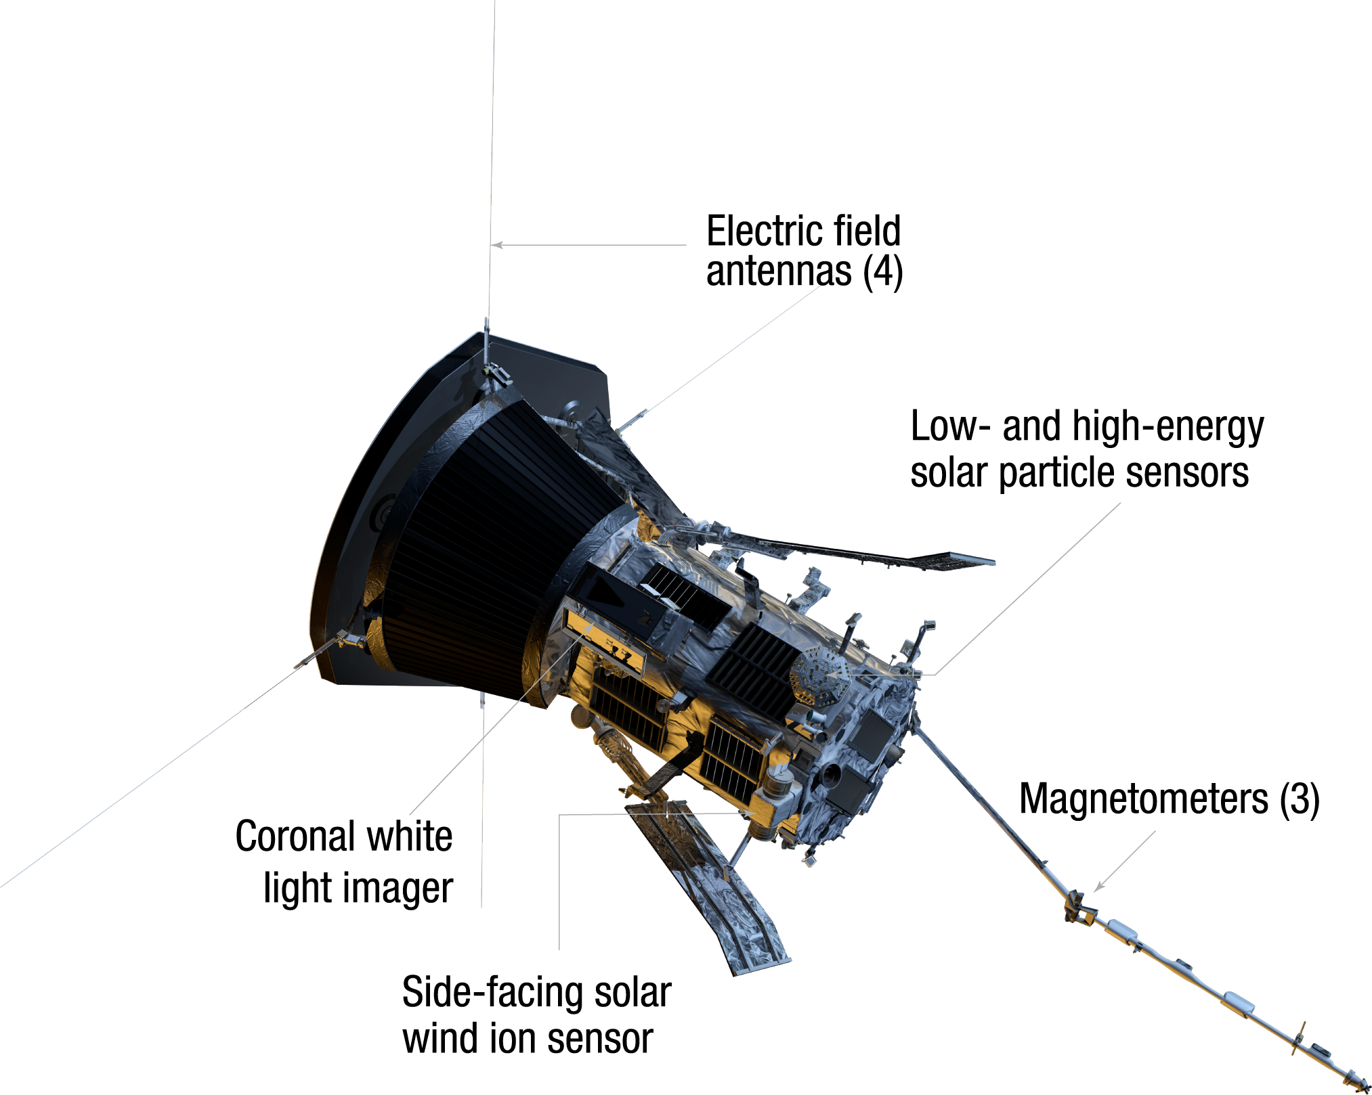
Basic Methodology
Utilize Solar Wind Electrons Alphas & Protons (SWEAP) and Electromagnetic Fields Investigation (FIELDS) data
  Proton velocity (RTN) from SWEAP
  Magnetic field strength (RTN) from FIELDS
Plot and analyze data with Anaconda then compare switchback identification with University of Michigan database
Advanced Physics Laboratory

Slide 9
Reproduction of Switchback Example

Slide 10

The Parker Spiral and Parker Angle
Parker Spiral a result of expanding atmosphere of Sun and rotation of Sun
The expected Parker Angle is computed using proton velocity values and the actual observed Parker angle is computed with magnetic field values
Used in previous identification methods
Observed
Expected
B_{φ} – tangential magnetic field
B_{r} – radial magnetic field
U_{φ} – tangential proton velocity
r – radial distance
Ω⊙ - equatorial solar rotation rate
U_{r} – radial proton velocity

Slide 11
Example of Expected vs Observed Parker Angle
Plot of Observed and Expected Parker Angle
Plot of Parker Angle Difference

Slide 12
Key Results
From 10/31/2018 to 11/05/2018, I detected 241 switchbacks
  Database detected 246 switchbacks
66% of switchbacks I identified matched data base (159/241)
Average switchback duration: 9:20
  Ranges from <1sec to 1 hr 55 min
Example of a database entry used for comparison

Slide 13
Identification of Biases
Many non-matching switchbacks were fractions of a second long and were possibly overlooked
Each switchback was treated independently and the possibility of switchbacks within switchbacks was not considered
The detection requirements used were not strictly defined and often relative to the data in the time period being analyzed
Compare with University of Michigan switchback database using Jupyter

Slide 14
Going Forward
Continue to analyze following encounters with same methodology and observe what will change as the spacecraft gets closer to the Sun
Develop automated identification procedure and compare to manual detection results and other identification methods
Apply findings to challenge switchback theories including magnetic reconnection, shear-driven turbulence, and slow/fast wind interaction

Slide 15



Acknowledgements
Dr. Kristopher Klein
Faculty Mentor
Dr. Mihailo Martinovic
Postdoctoral Mentor
Josh Smith
Intern Advisor

Slide 16
Thank You!

